Slide 1
Logistic Regression
1

Slide 2
Logistic regression
Aiming to generalize to unseen data
Data
Task
Representation Score Function
Search/Optimization Models, Parameter, Metric
Task ?/Data
Regression Supervised (Y is a continuous)
Learning theory (About f())
Classification Supervised (Y is a discrete )
unsupervised NO Y
Images (About interactions among Y,X1,
Reinforcement Learning (Xp Learn to Interact with environment
2

Slide 3

_{e}β₀ +β x
T
Logistic Regression Classifier
P( y = 1 x) = _{T}
_{1+ e}β₀ +β x
Data: X
Task: y
Representation: : x, f() Score Function: L()
Search/Optimization : argmin()
Models, Parameters, metrics
X: Tabular/ 2D
Binary Classification
Log-odds y = linear function of Xs
MLE
Iterative (Newton) method
/ SGD
Logistic weights
/ Accuracy / F1
3

Slide 4

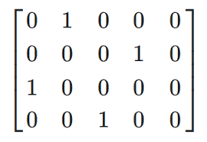

Review Bayes classifiers
Treat each feature attribute and the class label as random variables. .(c1,c2…)
Training: What is an appropriate loss for classification?
E.g. Compare training class to output class: Zero-One loss (per class)
Can we model/estimate p(C=C_{i} |x) = p( C_{i} | x₁, x₂, … , x_{p} ) directly from reference data?
4

Slide 5
Model the Bayes classifiers
Treat each feature attribute and the class label as random variables.
Testing: Given a sample vector x with attributes as ( x₁, x₂, … , x_{p} ):
Goal is to predict its class
HOW: we want to find the class that maximizes my model f(x) p( c | x₁, x₂, … , x_{p} ).
=➔Find p(c1| x) … p(c2| x) p(cL| x) … find max called C*
5

Slide 6
Bayes Classifiers – Predict via MAP Rule
Task: Classify a new instance X: based on:
X = X₁, X₂,😐, X_{p}
c_{MAP} = argmax P(c_{j} | x₁, x₂,😐, x_{p} )
c_{j} ∈C
MAP Rule
MAP = Maximum Aposteriori Probability
10/1/20
10

Slide 7



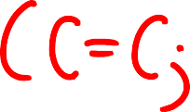

Bayes Classifiers – Predict via MAP Rule
Establishing a probabilistic model for classification
➔ MAP classification rule
➔ To Assign x to c* if
P(C = c* |X = x) > P(C = c |X = x)
for c ≠ c* , c = c ,⋅⋅⋅,c
1
L
10/1/20
11
Adapt from Prof. Ke Chen NB slides

Slide 8
Recap: Statistical Decision Theory (Extra)
Random input vector: X
Random output variable: Y
Joint distribution: Pr(X,Y )
Loss function L(Y, f(X))
Expected prediction error (EPE):
EPE( f ) = E(L(Y, f (X ))) = ∫ L(y, f (x))Pr(dx, dy)
e.g. = ∫ (y − f (x))² Pr(dx,dy)
Consider population distribution
e.g. Squared error loss (also called L2 loss )
10/1/20
12

Slide 9




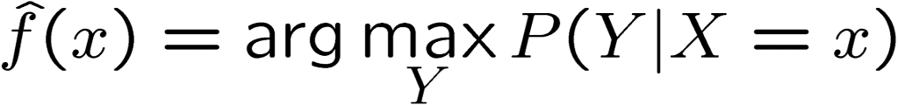



Recap: : WHEN Expected prediction error (EPE) USES DIFFERENT LOSS (Extra)
Loss Function | Estimator
L₂
L₁
0-1 | (Bayes classifier / MAP)
Use the mean such in Regression or KNN
10/1/20

Slide 10


C
Establishing a probabilistic model for classification
Output as Discrete Class Label
C₁, C₂, …, C_{L}
c = argmax P(c | x , x ,😐, x )
MAP
j 1 2 p
c_{j} ∈C
Generative
argmaxP(c | X ) = argmaxP(X ,c) = argmaxP(X |c)P(c)
c∈C c∈C c∈C
Later!
Discriminative
argmax P(c | X) C = {c₁ ,⋅⋅⋅,c_{L} }
c∈C

Slide 11

Three major groups of classifiers
We can divide the large variety of classification approaches into roughly three major types
1. Discriminative
directly estimate a decision rule/boundary from data
e.g., support vector machine, decision tree,
e.g. neural networks (NN), deep NN
2. Generative:
build a generative statistical model (such as using Bayes rule)
e.g., Bayesian networks, Naïve Bayes classifier
Instance based classifiers
Use observation directly (no models)
Deep Learning

Slide 12
Example of a model f(x)= p(c|x) : x→ C
– Discriminative Classifiers
argmax P(c | X), C = {c₁ ,⋅⋅⋅,c_{L} }
c∈C
P(c₁ |x) P(c₂ |x) P(c_{L} |x)
• • •
Discriminative Probabilistic Classifier
f(x)
• • •
x₁ x₂ x_{p}
Input
x = (x₁ , x₂ ,⋅⋅⋅, x_{p} )
10/1/20
16
Adapt from Prof. Ke Chen NB slides

Slide 13

Bayes Classifier
Task
Classification
Representation
c_{MAP} = argmax P(c_{j} | x₁, x₂,😐, x_{p} )
c_{j} ∈C
Score Function
MLE
Search/Optimization
？
Models, Parameters
Parameters in P(C|X).

Slide 14
_{e}β₀ +β x
T
Simplest discriminative classifier: Logistic Regression Classifier
P( y = 1 x) = _{T}
_{1+ e}β₀ +β x
Data: X
Task: y
Representation: : x, f() Score Function: L()
Search/Optimization : argmin()
Models, Parameters, metrics
X: Tabular
Binary Classification
Log-odds y = linear function of Xs
MLE
Iterative (Newton) method
/ SGD
Logistic weights
/ Accuracy / F1
P(y=0|x)=1-p(y=1|x)

Slide 15
Multivariate linear regression to Logistic Regression
Logistic Regression p(y|x)
𝑦 =
𝛽! + 𝛽"𝑥" + 𝛽#𝑥#+. . . +𝛽$𝑥$
Logistic regression for binary classification
P(y=0|x)=1-p(y=1|x)
Log-odds
⎡ P( y | x ) ⎤
ln ⎢ ⎥ = β₀ + β₁ x₁ + β₂x₂ +... + β_{p}x_{p}
1− P( y x )
⎢⎣
⎥⎦
⎢ = β₀ + β₁ x₁ + β₂x₂ +... + β_{p}x_{p}
Logit= log(p(yes|x)/p(no|x)=

Slide 16

⎢ β₀ + β₁ x₁ + β₂x₂ +... + β_{p}x_{p}
Y=Logit= log(p(yes|x)/p(no|x)=
_{e}β₀ +β₁x₁ +β₂x₂+...+β_{p}x_{p}
1
P(y =yes x) =
_{1+ e}β₀ +β₁x₁ +β₂x₂+...+β_{p}x_{p}
= _{T}
_{1+ e}−( β₀ +β X )

Slide 17
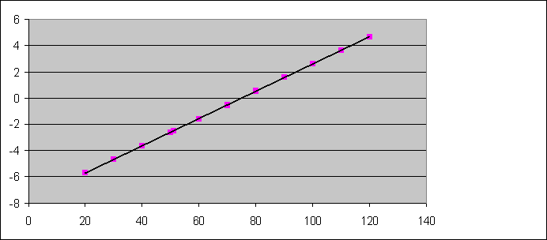
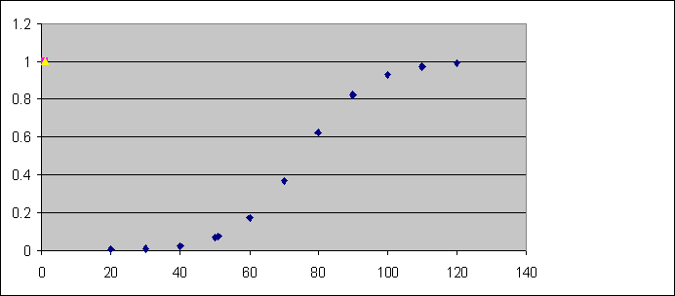

Binary Logistic Regression: Geometric
ln[p/(1-p)]
x
P (Y=1|x)
P(y=1|x) 1-p(y=1x)
1/20
x
22

Slide 18
logit of p(y=1|x) is linear function of x
View I:
⎡ P( y | x ) ⎤
ln ⎢ ⎥ = β₀ + β₁ x₁ + β₂x₂ +... + β_{p}x_{p}
1− P( y x )
⎢⎣
⎥⎦
{
Logit function
Logit of P(y|x)
10/1/20
23

Slide 19
Model Y as Bernoulli:
View II:
ln[p/(1-p)]
x
P (Y=1|x)
P(y=1|x) 1-p(y=1x)
1/20
x
24

Slide 20
View II: Model Y as Bernoulli:
e.g. Probability of disease
P (Y=1|X)
_{e}α+βx
1.0
P(y x) =
_{1+ e}α+βx
0.8
1-p(y=1x)
0.6
0.4
P(y=1|x)
0.2
0.0
x

Slide 21

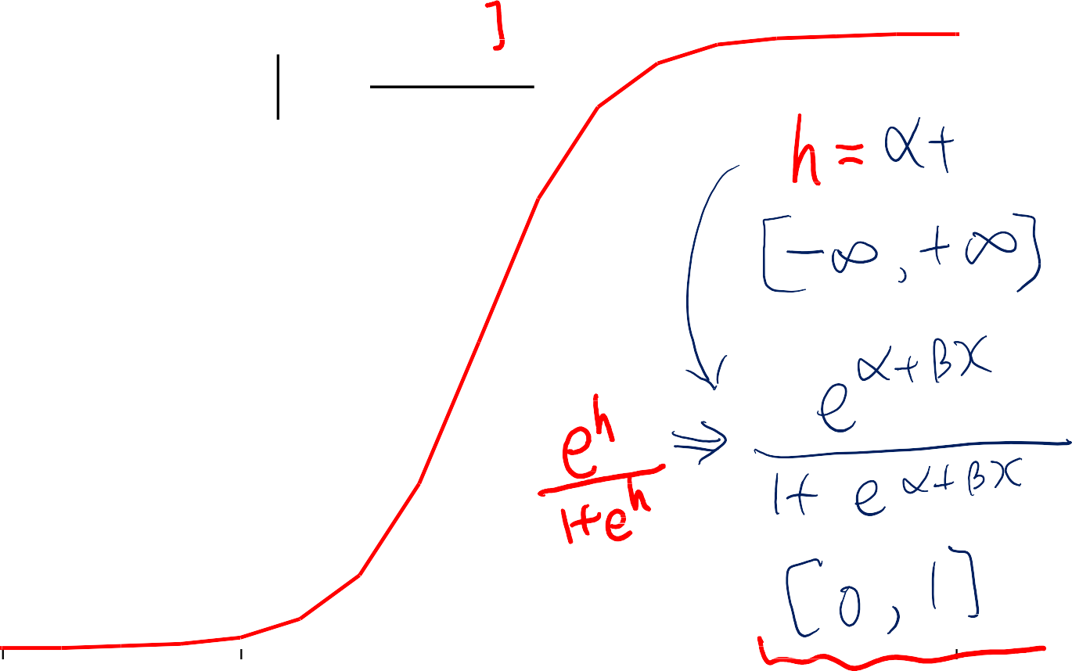
"S" shape function compress output to [0,1] Linear regression + Sigmoid function
View III:
P (Y=1|X)
1.0
_{e}α+βx
P(y x) =
_{1+ e}α+βx
0.8
0.6
0.4
0.2
0.0
x

Slide 22
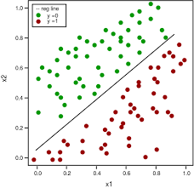

Logistic Regression models
View IV:
a linear classification boundary!
y ∈{0,1}
⎡ P( y | x ) ⎤
ln ⎢ ⎥ = β₀ + β₁ x₁ + β₂x₂ +... + β_{p}x_{p}
1− P( y x )
⎢⎣
⎥⎦
What if p(y=1|x)=p(y=0|x)? Cannot make a decision
Decision Boundary ➔ equals to zero
_{ln} ⎡ P( y = 1| x) ⎤ _{= ln} ⎡ P( y = 1| x )
⎤ = α + β x + β x +... + β x
⎢ P( y = 0| x ) ⎥ ⎢1− P( y = 1| x ) ⎥
1 1 2 2 p p
⎣ ⎦ ⎣ ⎦
Log 1=0 =➔ equation equals to zero

